Slide 1



High-density PCB assemblies for space applications : from evaluation to qualification
m. Cauwe (imec), C. NAWGHANE (IMEC), M. Van de Slyeke (ACB),
A. Coulon (TAS Belgium), T. Andre (TAS Belgium), S. HELTZEL (ESA/ESTEC)
5th SPACE PASSIVE COMPONENT DAYS – SPCD 2024
15-18 October 2024, ESTEC, The Netherlands

Slide 2
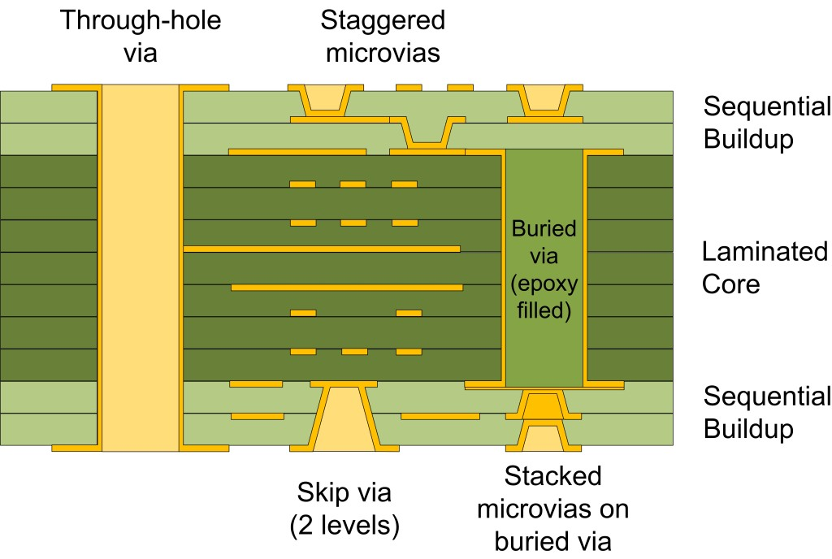
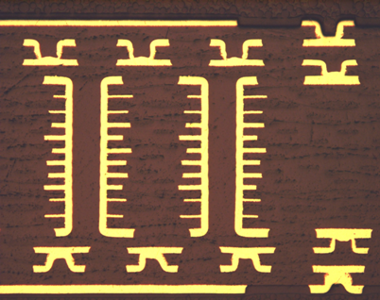
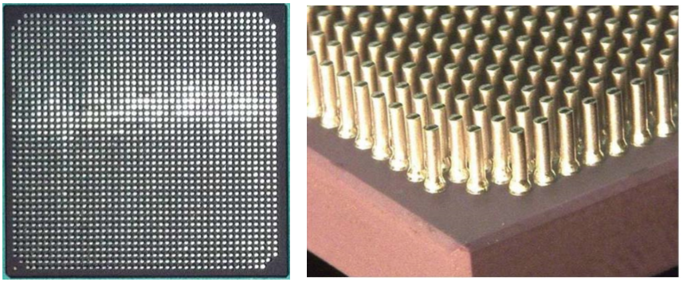
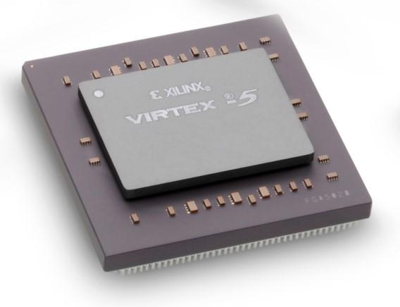
High Density PCB assemblies for space applications
introduction
Large ASICs (Application Specific Integrated Circuits) and FPGA (Field Programmable Gate Arrays) are now commonly used on-board spacecraft
New generation FPGAs (Virtex-5QV from Xilinx) have pin count above 1000 pins, with an interconnect pitch reduced to 1.0 mm
Fan-out routing for these packages requires high-density interconnect (HDI) PCBs using microvias and fine lines
© Data Respons
ACB
NASA - NEPP

Slide 3
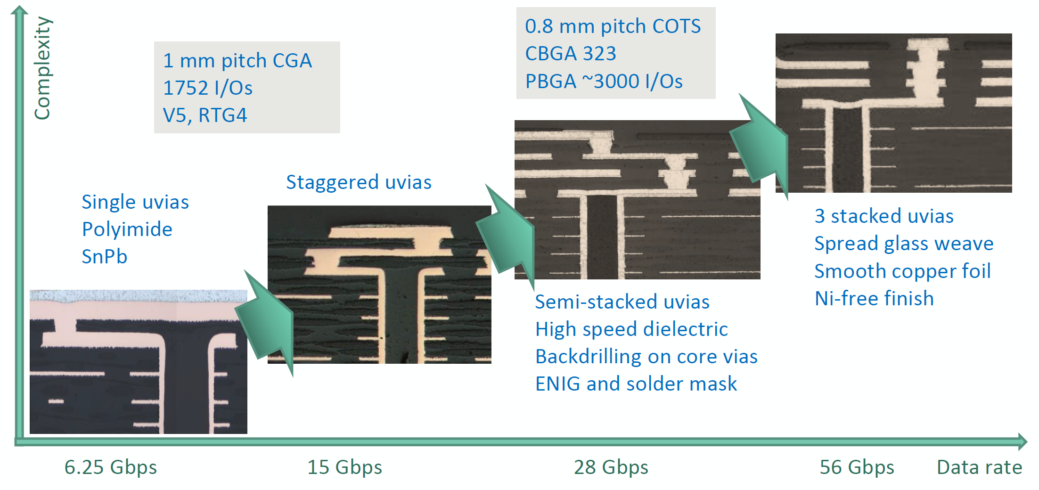
High Density PCB assemblies for space applications
HDI PCB technology development roadmap
ECSS-Q-ST-70-14C
Not Qualified
HDIPCB project objectives:
Qualify, Verify, Evaluate & Investigate

Slide 4
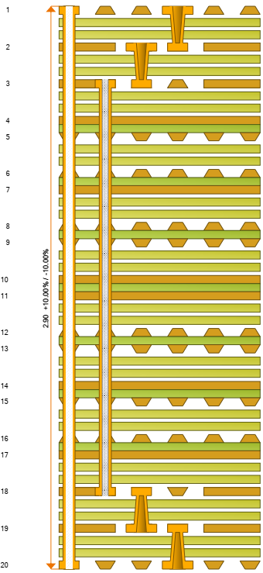
High Density PCB assemblies
Basic HDI technology
Technology parameter | Basic HDI
Conductor width and spacing | 70/70 µm (no plating, 17 µm Cu foil)
Configuration of microvias | 2 levels staggered, copper filled, 175 µm diameter
Number of layers | ≤ 20
Construction of HDI layers | Microvias staggered to core, two sheets of prepreg
Aspect ration of core vias | ≤ 7
PCB thickness | 2.8 mm
Filling medium for core vias | Via plugging paste (+ cap plating)
Construction of core | Single sequence
Dielectric material | Polyimide (Ventec VT-901)
Surface finish and solder mask | SnPb, no SM

Slide 5
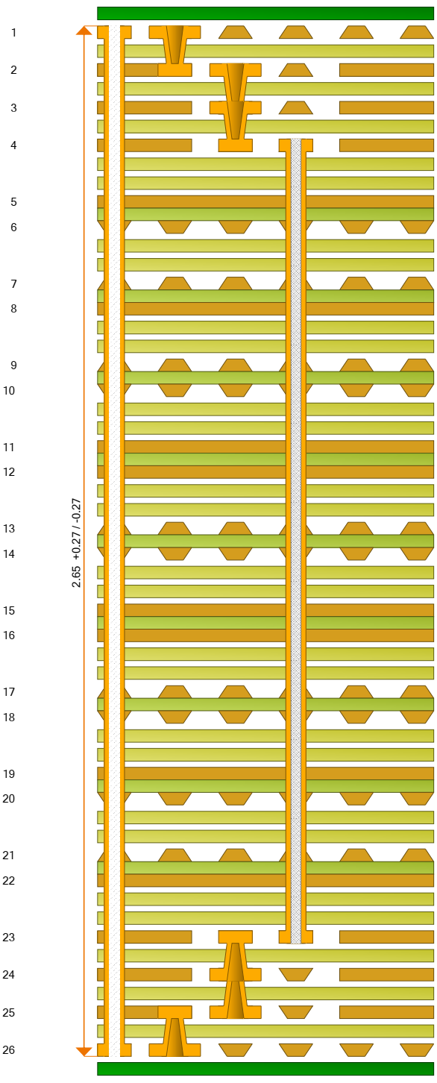
High Density PCB assemblies
complex HDI technology
Technology parameter | Complex HDI
Conductor width and spacing | 50/50 µm (no plating, 12 µm Cu foil)
Configuration of microvias | 3 levels, Cu fill, 125 µm diameter Semi-stacked configuration
Number of layers | ≤ 26
Construction of HDI layers | Staggered, one sheet of prepreg
Aspect ration of core vias | ≤ 10
Filling medium for core vias | Via plugging paste (+ cap plating)
Construction of core | Single sequence
Presence of non-functional pads | Full pad stack removed
Back drilling | Buried vias
Dielectric material | Ventec VT-901 and Megtron 6
Surface finish and solder mask | ENIG or ENEPIG with solder mask

Slide 6
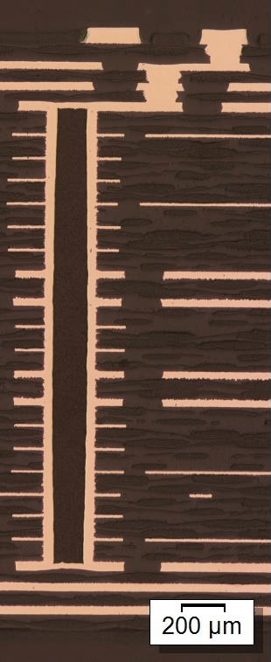
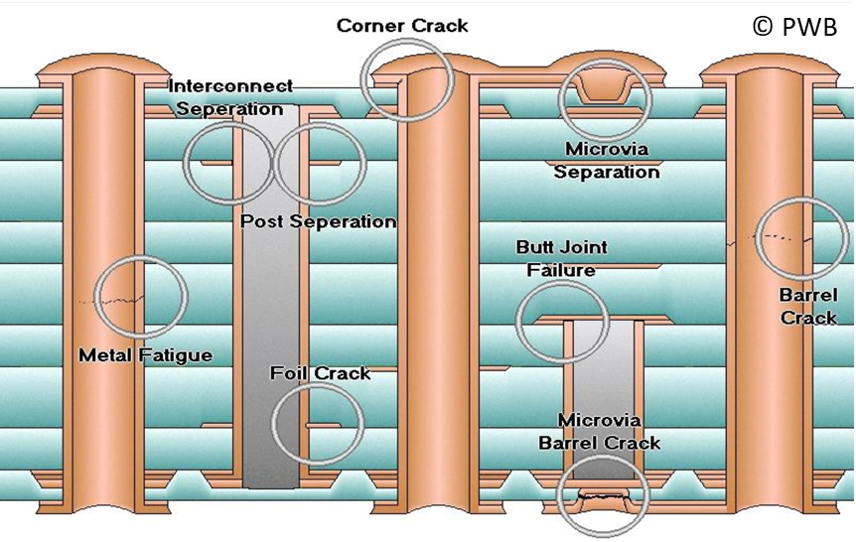
High Density PCB assemblies for space applications
Hierarchy of failure for HDI technology

Slide 7
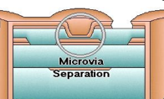
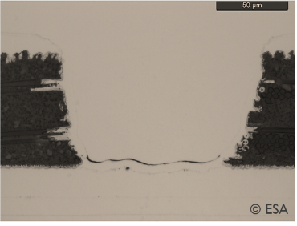
Lessons learnt on microvias
Weak microvia interface
Microvias can fail for the following reasons:
  Non-optimised materials or processes
  Stressful design
  Inhomogeneous processes
Weakness in microvia target land interface is not caused by any single manufacturing process
ESA evaluates microvia designs using
  review of design and comparison to qualification
  thermo-mechanical modelling
  testing coupons and spare PCBs
  review of manufacturing processes

Slide 8
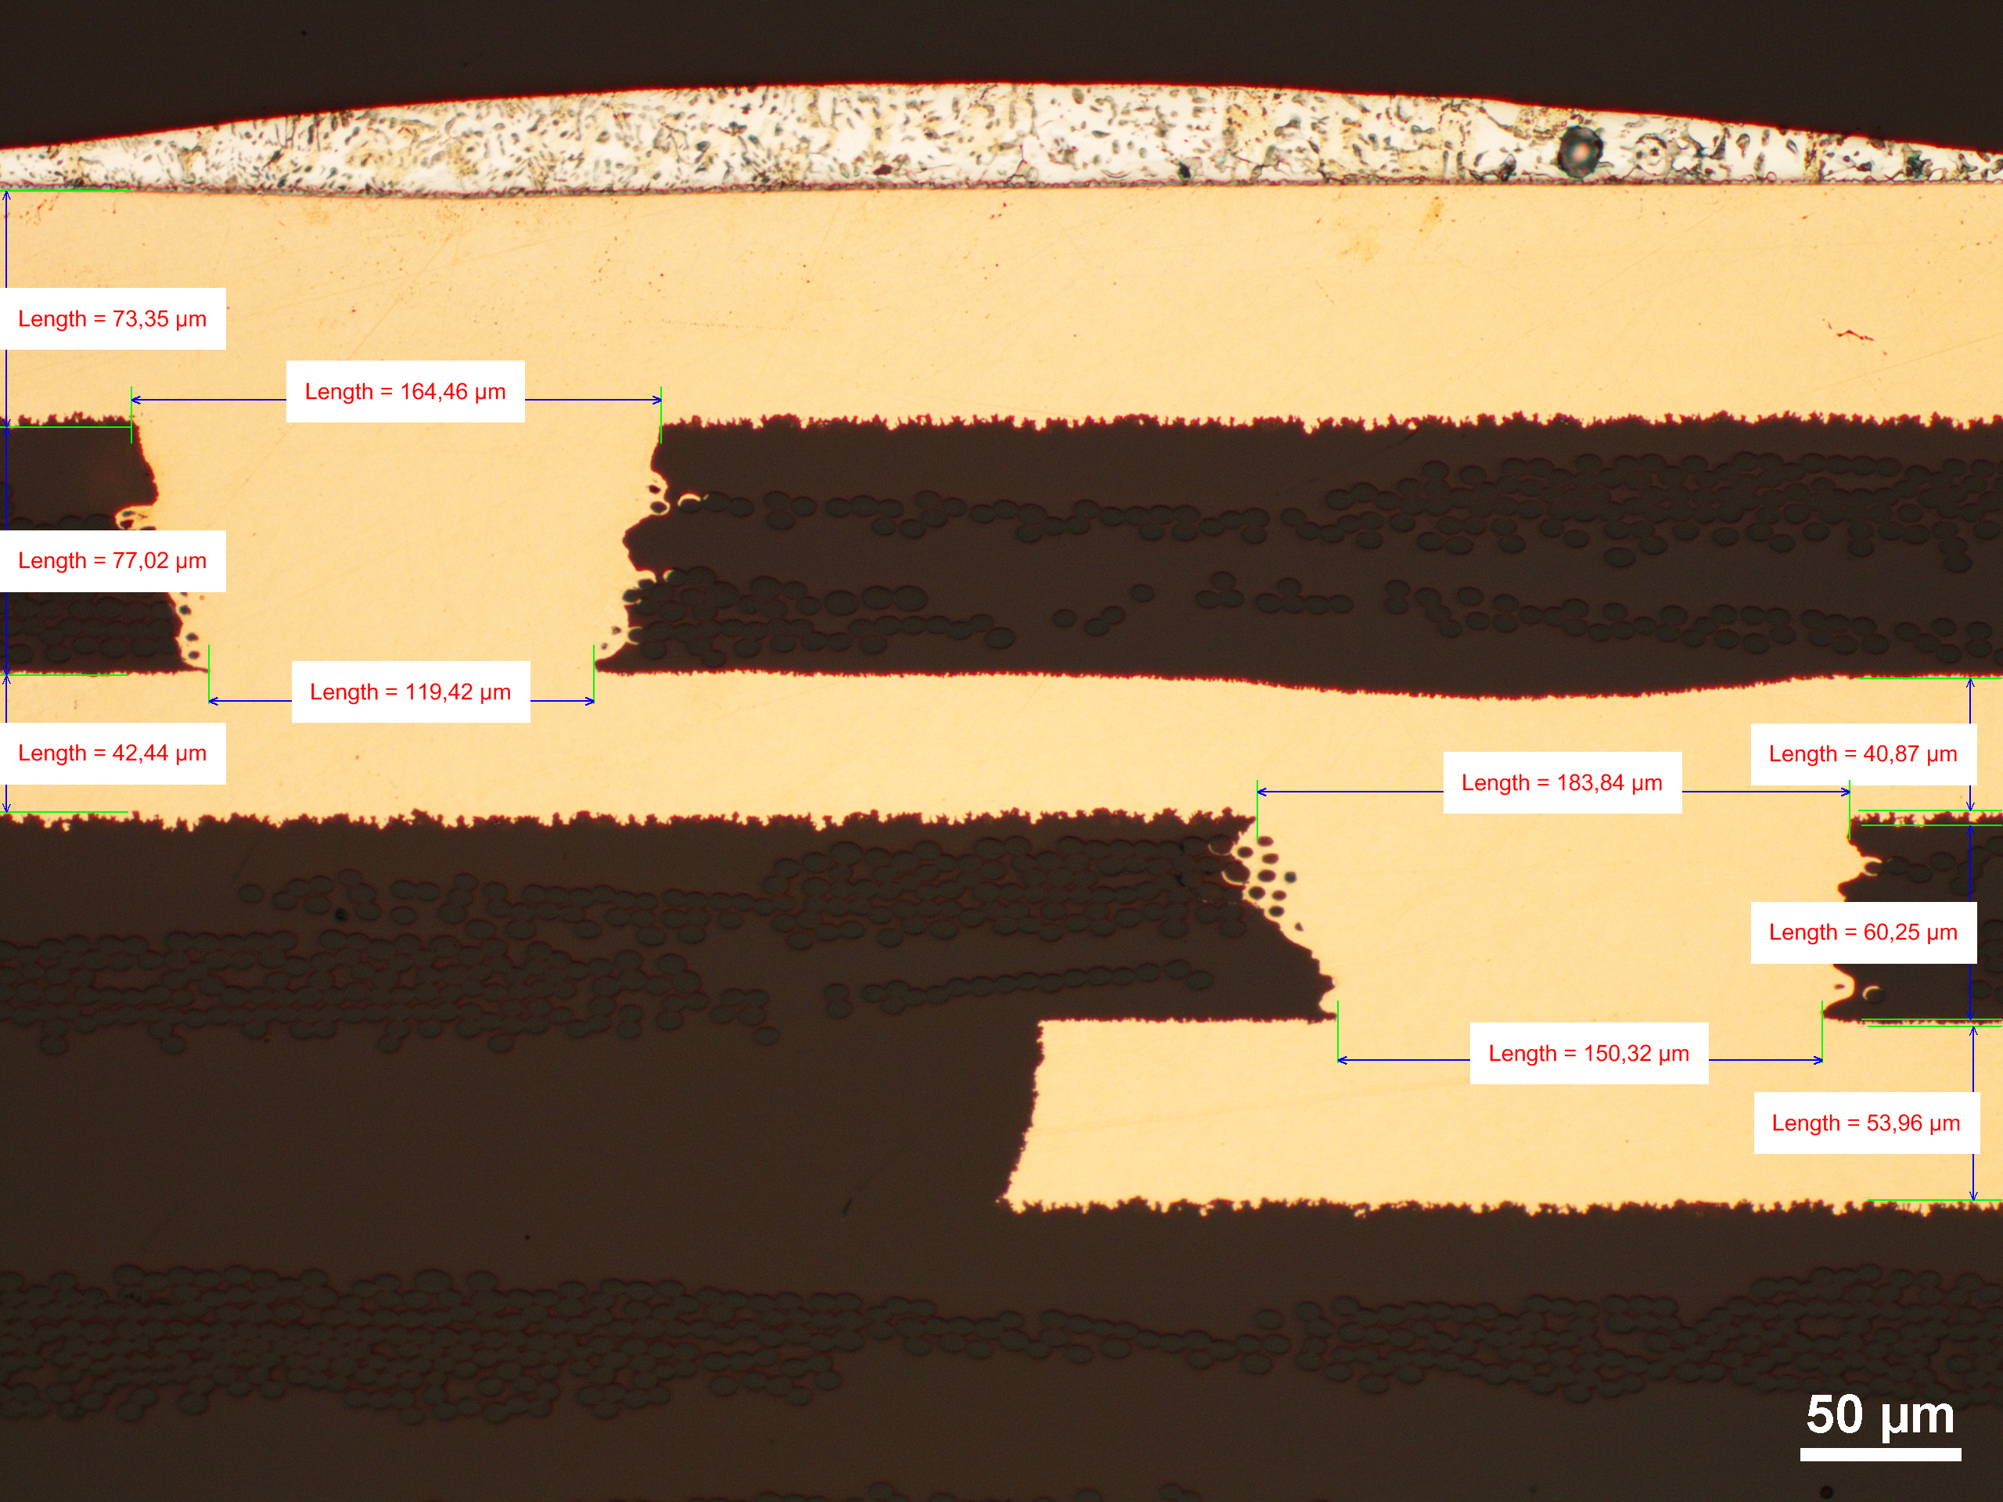
Lessons learnt on microvias
W
review of design and manufacturing processes
ESA microvia process guidelines: ESA-TECMSP-TN-19672
Aspect ratio of 0.66 to 0.75 advised for high-quality microvias
Dielectric thickness is important contributor to aspect ratio
Design recommendations
  Use the microvia layers as plane layers (max Cu area)
  Select prepreg construction for worst-case Cu thickness
Manufacturing recommendation
  Minimize copper thickness on microvia layers
H
<< The qualified domain only covers microvia layers with 2x 106 prepreg construction. This automatically limits the maximum copper thickness that can be allowed to ensure an as-manufactured minimum dielectric thickness of 60 µm. >>

Slide 9
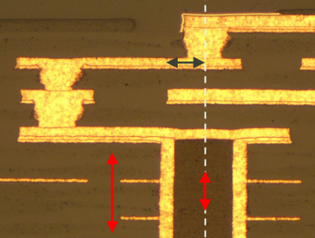
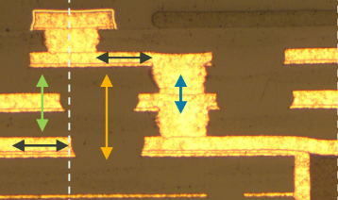
Lessons learnt on microvias
Design recommendations
Distance between microvia stack and core via should be maximized (design rule: tangency of the pads)
Microvia placement superimposed to the core via is not recommended
  If superimposing microvias above the core via cannot be avoided, concentric placement is advised
Plugging paste and high copper thickness reinforce the core via, which can result in rotational stress on the microvia stack
Areas of high-resin content surrounding the microvia can exert additional stress on the microvia
Tightly spaced microvias act as rivets [G. Partida]

Slide 10
Lessons learnt on microvias
General recommendations
A through review of manufacturing processes is key to achieving high-quality microvias
Careful design can dramatically improve the robustness of the microvia
  Staggered microvias are less likely to fail, but do not ensure safe passage
  Three levels of stacked microvias will not reduce the reliability of the HDI PCB if designed carefully, manufactured properly and assembly is performed with caution
All accelerated test methods can differentiate between microvia configurations and be used to assess the capability of a manufacturing process
A thorough understanding of the impact of design variables, manufacturing processes and test parameters is more important than the choice of microvia test method

Slide 11
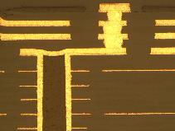
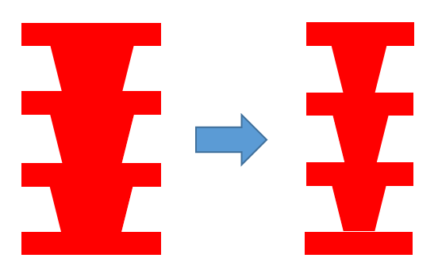
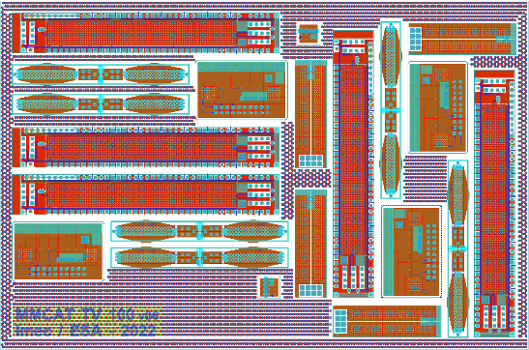


Follow-up activity on microvias
EU IPC UVIA Working group
PCB experts from EU high-rel electronics manufacturing industry jointly address the microvia reliability concern
Execute a round-robin campaign using a standard test panel based on consolidated design drivers
  Three stacked microvias, off-set to core via (~90% of high-rel)
Validate test methodology by evaluating all relevant accelerated coupon test methodologies
  IST, CITC, HATS2 and OM testing
Benchmark manufacturing capability by step-wise reduction of microvia drill diameter
  ∅ 175, 150, 125, 100 um in 100 um dielectric
Contact Stan.Heltzel@esa.int in case of interest

Slide 12
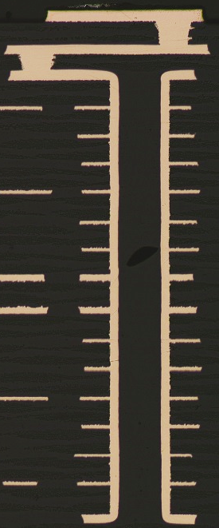
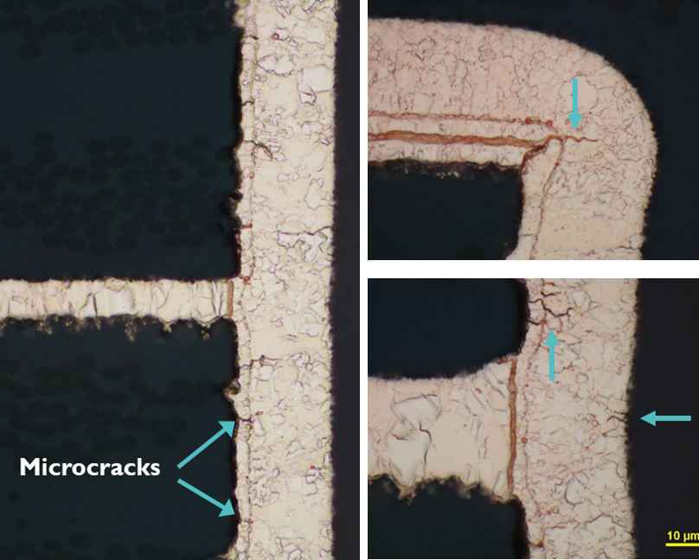
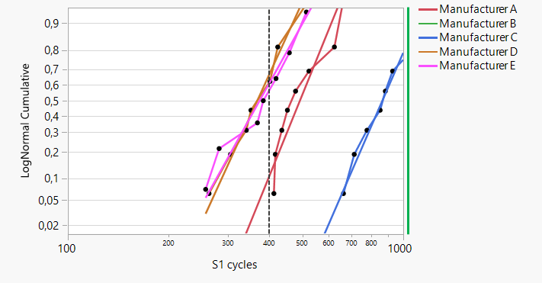
Lessons learnt on Core vias
Early failures
Microcracks observed after thermal cycling (Polyimide, T = 200 °C)
Interconnect stress testing does not reach requirement of 400 cycles

Slide 13
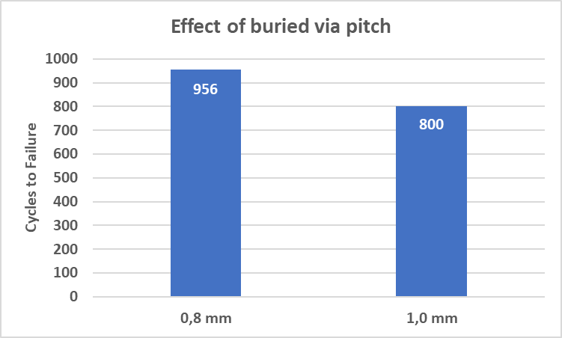
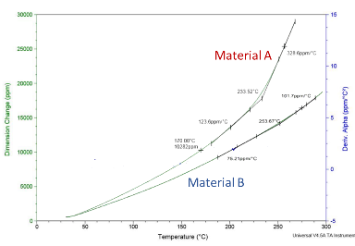
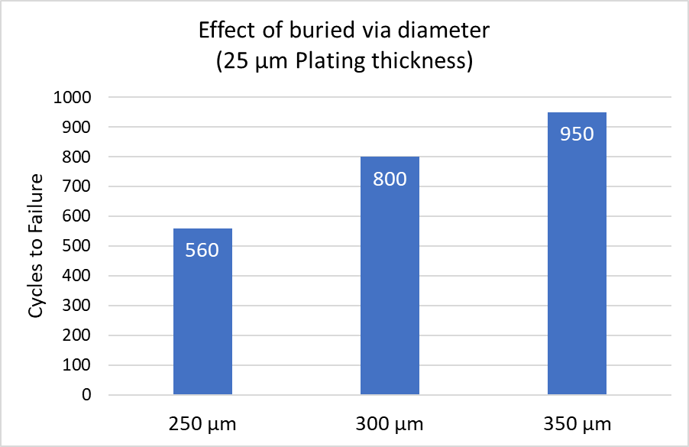
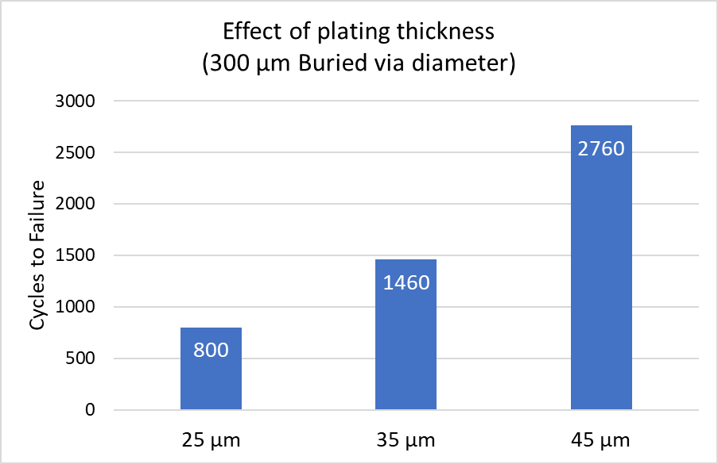
Lessons learnt on Core vias
Contributing factors
Failure mechanism for buried vias differs from (unfilled) through holes
Contribution from design, material choice, manufacturing parameters and end-use environment conditions
-50 %
+20 %
Effect of non-functional pads
+70 %
+250 %
+20 %
-30 %
+80 %

Slide 14
Lessons learnt on Core vias
General recommendations
The thermal expansion of the base material remains of key importance
A core via with a larger diameter is inherently stronger and easier to manufacture
A higher plated copper thickness inside the core via improves reliability (until it doesn’t)
While a smaller pitch results in higher endurance, do not use as a design feature
Removing non-functional pads increases the endurance of the core via
The thermomechanical properties of the material inside the core via need to be match to those of the base material
  If the resin of the base material can be used to fill the core via, the isotropic expansion of that resin can introduce early failures
  Using a plugging paste typically creates a stronger barrel, which can have a negative impact on its surroundings

Slide 15
Lessons learnt on Core vias
Revised technology parameters
Basic HDI as qualified
Two levels staggered, copper filled, 175 µm diameter
Microvias staggered to core vias, two sheets of prepreg
Core via aspect ratio ≤ 7 (350 µm diameter = 6.7)
Core via pad diameter of 650 µm
70/70 µm line width & spacing
2.8 mm max thickness, ≤ 20 layers
Plugging with cap plating
Polyimide (Ventec VT-901)
Full NFP stack removed on core vias (17 µm & 35 µm Cu foil)
35 µm average plated Cu thickness, 30 µm minimum
Following the investigations into contributing factors, the following changes were made to the technology parameters for basic HDI
  Increase drill diameter to 350 µm (aspect ratio 6.67:1)
  Increase average copper thickness to 35 µm
  Use plugging paste and cap plating
  Remove all non-functional pads
Preliminary results from limited set of coupons
  IST endurance increased from 400-900 cycles to 1400+ cycles for 1.0 mm pitch
  IST endurance increased from 400-650 cycles to 1500+ cycles for 0.8 mm pitch

Slide 16
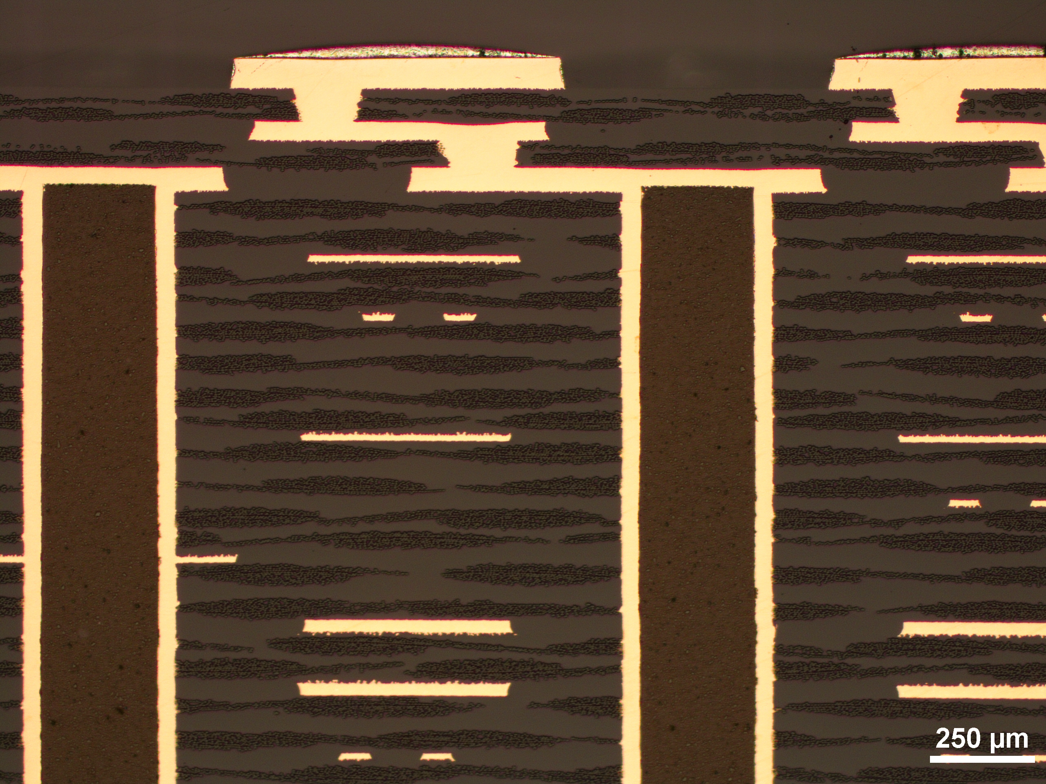
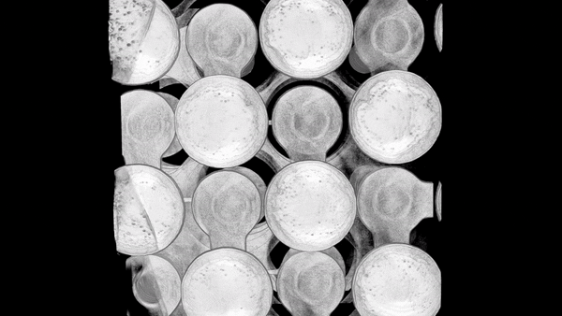
qualified HDI PCB technology For Space Applications
ESA's new dimension in printed circuit design
PCB manufacturer ACB in Dendermonde, Belgium, has received ESA qualification for HDI PCBs, as the successful outcome of a recent General Support Technology Programme contract led for ESA by Belgian research institute IMEC, with Thales Alenia Space Belgium as end user.

Slide 17
qualified HDI PCB technology For Space Applications
Design, manufacturing & testing considerations
Observation | Design | Manufacturing | Testing
MV annular ring | AAD representative coupon | None | DPA on PCB
Dielectric thickness | AAD representative coupon; Microvia layers as plane layers | Reduce target thickness for cap plating | DPA on PCB
Track width & spacing | None | None | DPA on PCB
Buried via cracks | Reduced aspect ratio; Removal of NFPs; Material change | Increased Cu thickness; Use of plugging paste | Covered by IST; group 6 not needed
Inclusions (CAF) | None | Cleanliness of layup area | None

Slide 18
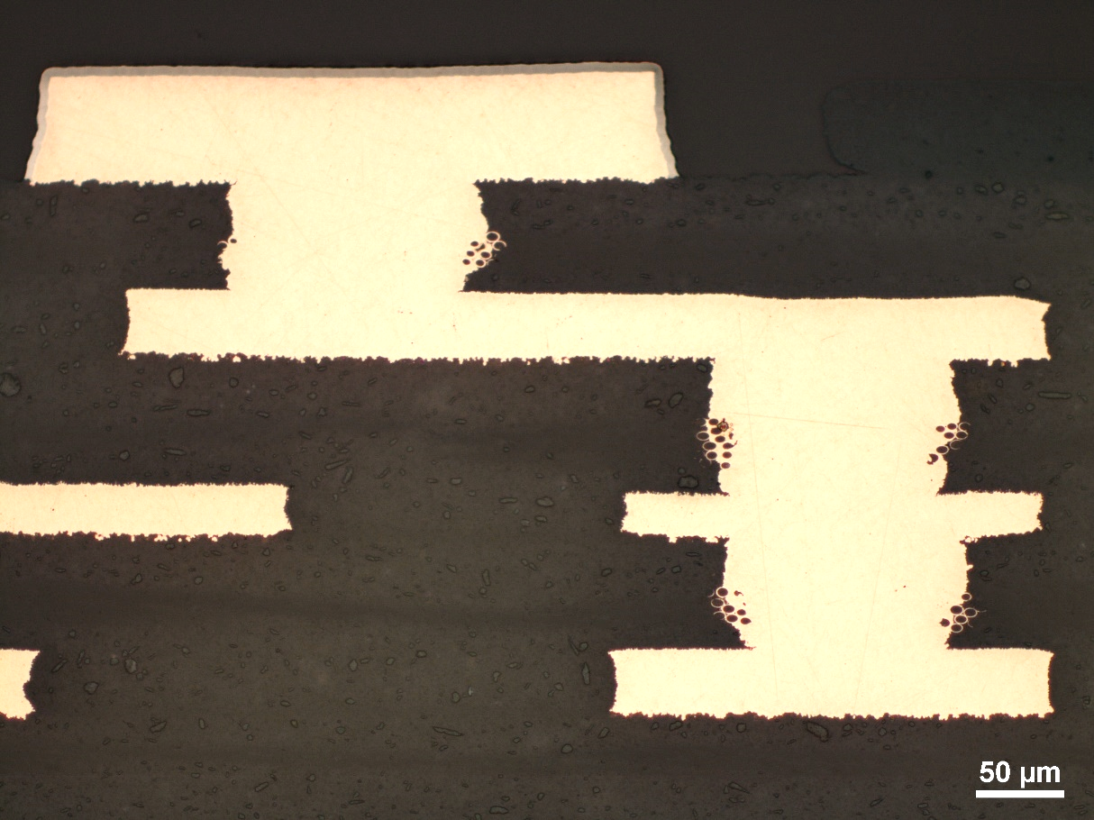
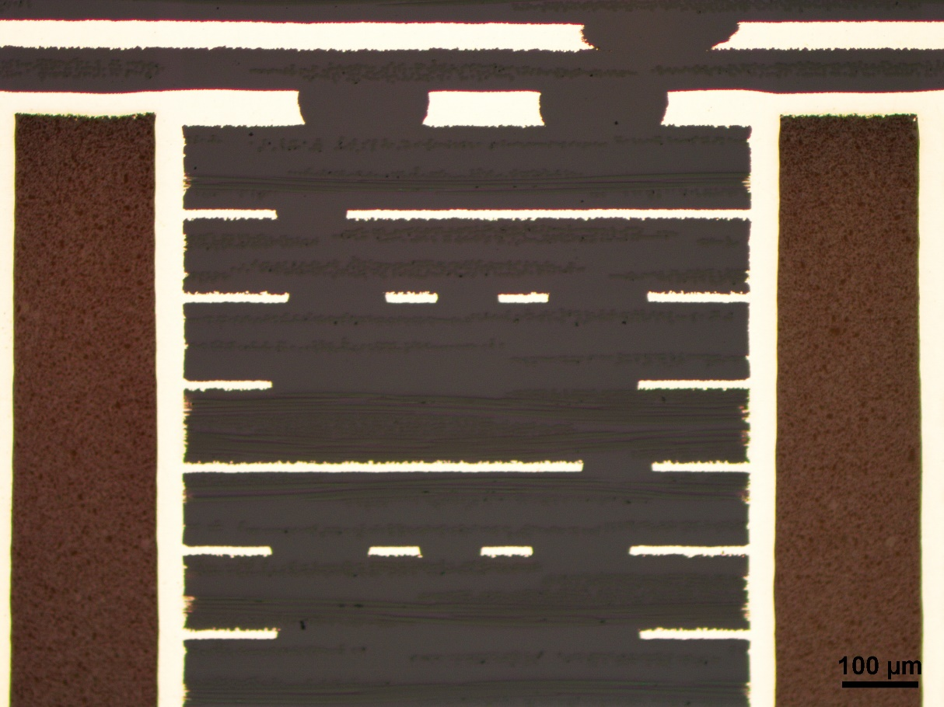
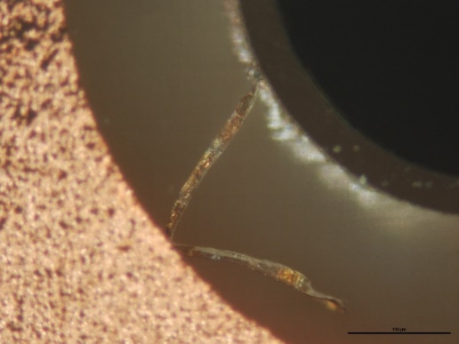
evaluation of Complex HDI TECHNOLOGY
Summary of results
The complex HDI technology introduces several new features, such as stacked microvias, single prepreg, solder mask and new surface finishes
  Semi-stacked inside microvia configuration passed all the required testing
  Dielectric thickness control with single prepreg to be further optimized
  High aspect ratio buried vias with plugging and cap plating remain a challenge
  Dielectric cracks in RF material observed after testing
  CAF performance is good, although cleanliness remains a concern

Slide 19
High Density PCB assemblies for space applications
HDI PCB technology development roadmap
ECSS-Q-ST-70-14C
Basic HDI : Qualified
Complex HDI : ready for qualification
HSHDI project objectives:
Qualify, Verify, Evaluate & Investigate

Slide 20
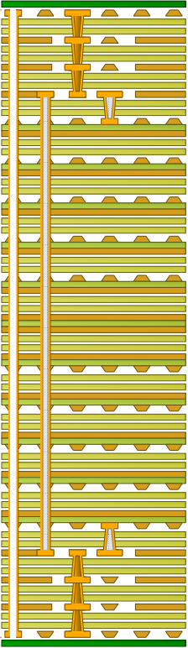
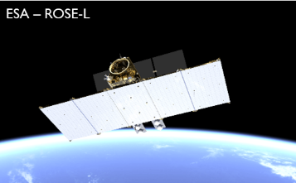
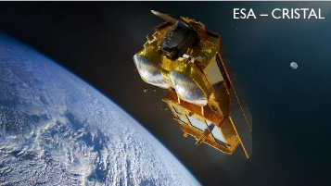
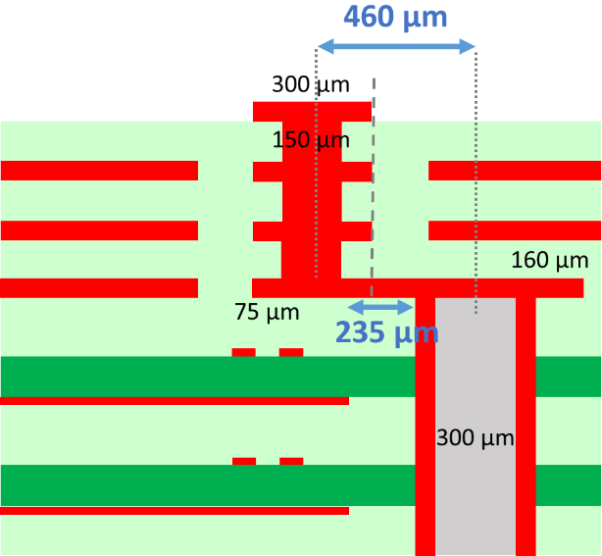
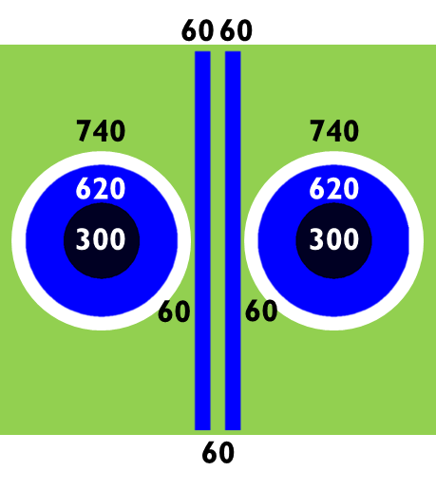
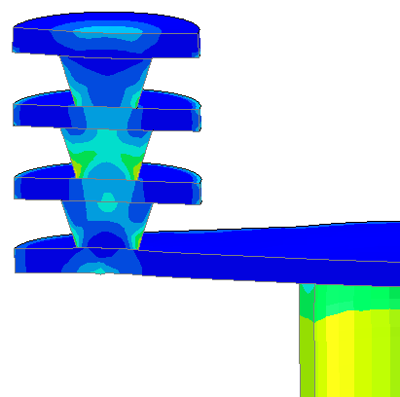
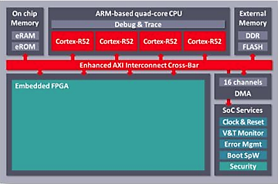


High Density PCB assemblies for space applications
High-Speed High-Density Interconnect
The need for on-board data processing is surging
HDI technology increases the routing density to allow interconnecting high pin-count devices with reduced pitch
High-Speed HDI technology enables signal and power integrity for higher data transfer rates and to accommodate high-performance components
1.01
1.56
1.30

Slide 21
High Density PCB assemblies for space applications
Further reading
M. Cauwe, S. Heltzel, J. Furlong, C. Nawghane, M. Van De Slyeke, and A. Coulon (2021), “Round robin testing of HDI technology from space-qualified PCB manufacturers,” Proceedings of the 21st IPC APEX EXPO, San Diego, CA.
M. Cauwe, C. Nawghane, M. Van De Slyeke, S. Heltzel, J. Furlong, B. Neves, and K. Knadle (2022), “Design and testing of three levels of microvias for high-reliability PCBs,” Proceedings of the 22nd IPC APEX EXPO, San Diego, CA.
M. Cauwe, A. Coulon, C. Nawghane, B. Vandevelde, M. Van De Slyeke, and S. Heltzel (2022), “Microvia technology assessment for space applications,” SMTA Europe Electronics in Harsh Environments Conference, The Netherlands.
M. Cauwe, S. Heltzel, J. Furlong, C. Nawghane, M. Van De Slyeke, and A. Coulon (2021), “Round robin testing of HDI technology from space-qualified PCB manufacturers,” Proceedings of the 21st IPC APEX EXPO, San Diego, CA.
M. Cauwe, C. Nawghane, A. Coulon, M. Van De Slyeke, and S. Heltzel (2023), “Contributing factors to the reliability of buried vias in high-density interconnect PCBs,” Proceedings of the 23rd IPC APEX EXPO, San Diego, CA.

